Slide 1

Welcome
NorCal
Team Managers
August 30, 2026

Slide 2
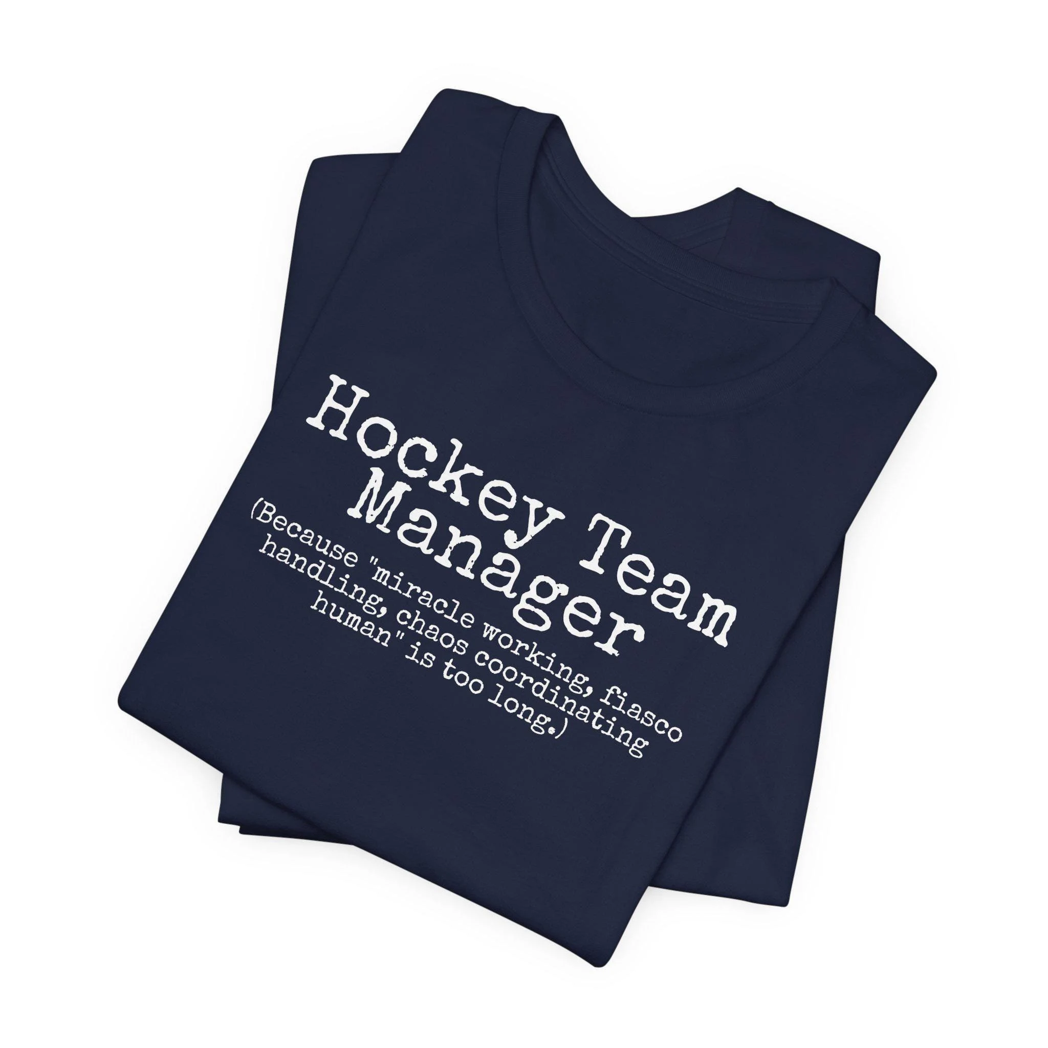
Congratulations on the Team Manager role!

Slide 3

Team Manager Responsibilities
Team Roster
Scoresheets, labels and signatures/stats reporting
Tournament Coordination
Ensure adherence to NorCal, CAHA, USA Hockey policies and guidelines

Slide 4
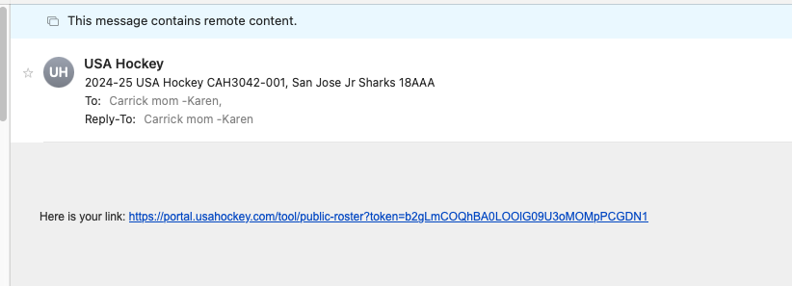
TEAM ROSTER = license to play
(club registrar will send link once approved)
To be added to your roster:
All players are age and birthplace verified
Non-US Citizens must be transferred to USA Hockey
All players and team staff must have completed ABI
Team staff and players born after 2008 require SafeSport
All team staff require Background Screen
Coaches CEP 1-5 by 12/31/26

Slide 5
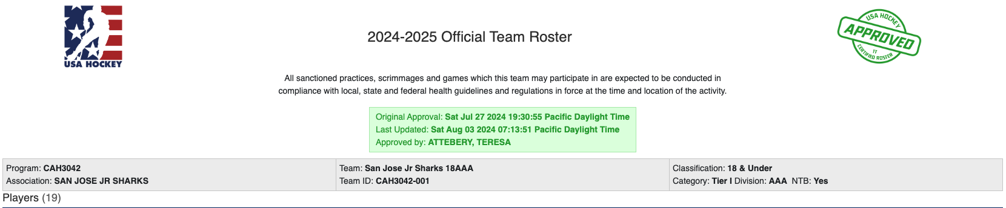
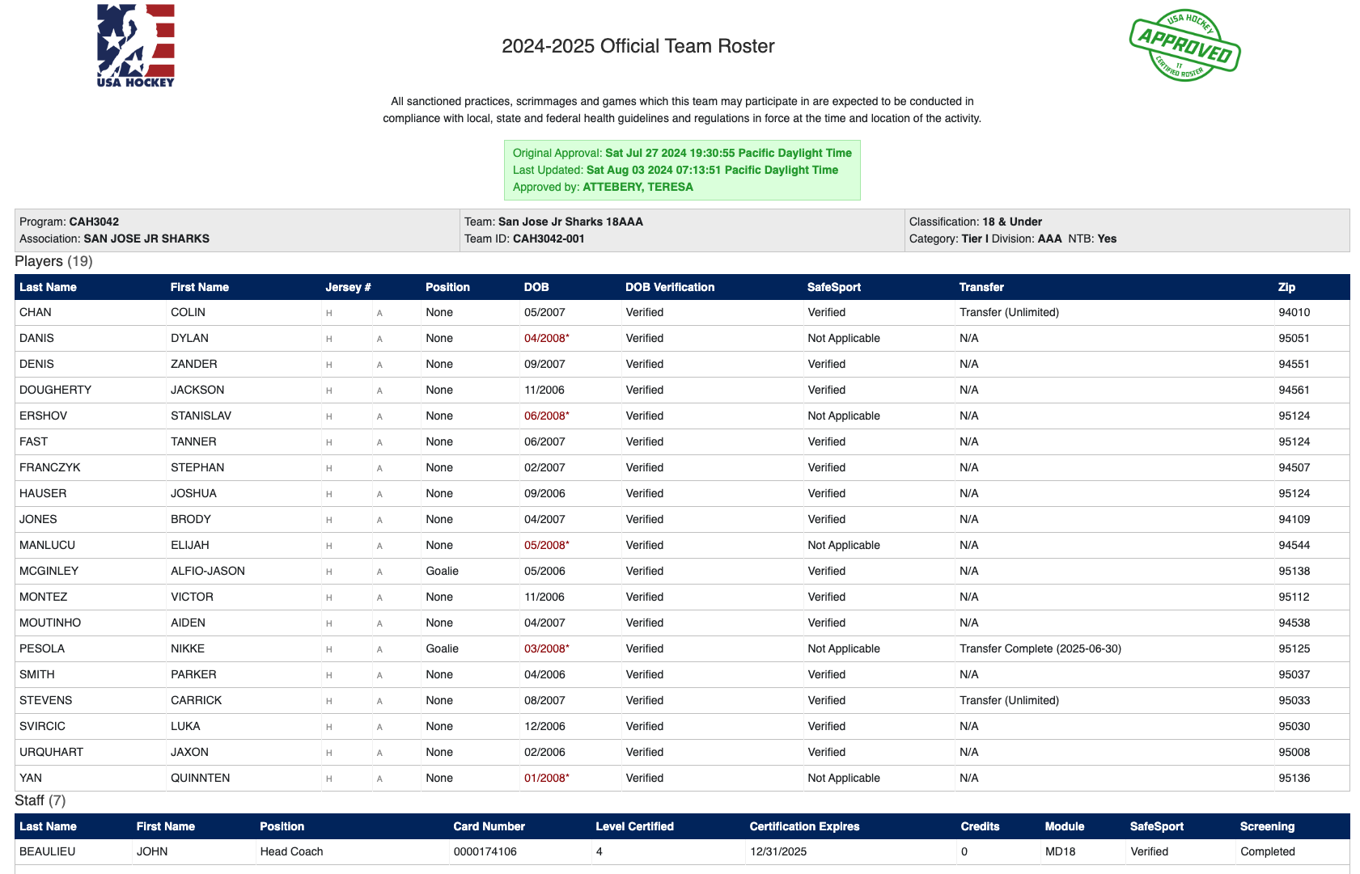

Slide 6
Important Reminders Rostering
All NorCal Travel Rosters 10-14U start as B (will update after preseason)
No 8u player OR goalie shall play up
After December 31, any emergency goalie for a 12AA/A/BB/B team must be from a lower level and pre-approved by NorCal
10B is only division that can take a goalie from another 10B team (lateral), or age-appropriate in-house goalie
Tournament rosters = add new player for tournament (21 days in advance)

Slide 7
Coach Rostering Requirements
Coaches must complete CEP by December 31 (if not, will be redlined)
Coach Temp Cards issued in 25-26 season - these coaches cannot be on a 26-27 roster, they were for the completion of the 25-26 season ONLY!
Coaches can’t be added to a roster without the required Age-Specific Module.
Coaching level for 6U/8U & Learn to Skate programs; it expires after 5 years.
No need for higher level CEP if only coaching 6U/8U or Learn to Skate programs.
USA Hockey LMS portal for Coaches started last season
MAXIMUM of 6 coaches on roster (and 4 on bench)
Student coaches count as 1 coach (and must wear helmet, face shield and neck guard)

Slide 8
Locker Room Monitors = USA Hockey Requirement
At least one responsible adult present monitoring the locker room during all team events to ensure only participants (coaches and players), approved team personnel and family members (at 8U and 10U ages) are in the locker room and to supervise the conduct in the locker room.
Any individual meetings with a minor participant and a coach in a locker room requires a responsible adult be with the coach (one-on-one actions between a coach and athlete must be “observable”).
Responsible adults must personally monitor the locker room environment at all times while participants are present and ensure the locker room is appropriately secured when minor participants are on the ice.

Slide 9
Locker Room Monitors
**Cell phones are not to be used in the locker rooms. This is a Safe Sport issue.**
**Any time a player leaves the bench during a game to go to the locker room, the locker room monitor needs to go with them.**
Must complete Background Screening and SafeSport

Slide 10
Penalty Box Attendants
Each team should have a Penalty Box Attendant for all league games. Tournaments may or may not require.
This person cannot be a coach who is serving a suspension.
No yelling or lobbying on Ice Officials about calls on the ice.
(If your rink does not provide scorekeepers, your team is responsible for having a scorekeeper for your Home games.)
Penalty Box Attendants and Score Keepers are considered off-ice officials and need to remain neutral at all times

Slide 11
GAME TIME
--
Be Organized!
Binder or paper organizer
Paper Game Sheets (prepare in advance)
Sticker labels
Copy of official roster (and link)
Pens
Home team provides game sheet for league games

Slide 12

Before the Game --
Score Sheets
Head Coach is ultimately responsible for accuracy of game sheets but you can help!
Incorrect game sheets can lead to a coach or player suspension!
Players or coaches not on your approved USA Hockey roster MUST NOT participate in games
Notes:
No presiging on game sheets or stickers

Slide 13
Before the Game --
Score Sheets
Names must match official roster
Last name first, no nicknames
Remember the Jr etc
Sticker templates can be found on NorCal Hockey; use AVERY full sheet
Ensure game sheets are legible
Use a single line to cross out people not there/suspended

Slide 14
Before the game
Check suspension lists
Ensure all players/coaches are on sheet and official roster (missing or red-lined = no go)
If player MAY come, do not cross out (coach should let scorekeeper know)
Designate Acting Head Coach if HC not available/suspended
Coaches sign game sheet just before game
Mark all suspensions with name/# of games ie Jr Sharks: C Stevens #14 serving 1 of 2 game suspension

Slide 15

End of Game Scorekeeper will…
Give the Scoresheet to the Referee and Linesmen to sign and finalize
Once signed by the referees, the scoresheet is the official record of the game and no changes can be made without head official approval
Find the home team manager and give them the scoresheet
Make Head Coach/Manager aware of any match penalties/game ejections handed out during game

Slide 16
Submitting Scoresheets
Home Team must upload PDFs of score sheets of league games to TTS (Time to Score) within 48 hours of each game (or fine will be issued). (Notify your registrar if there are issues)
Home and visiting teams must keep copies of completed game sheets for season
Tournament score sheets also need to be uploaded within 48 hours.

Slide 17
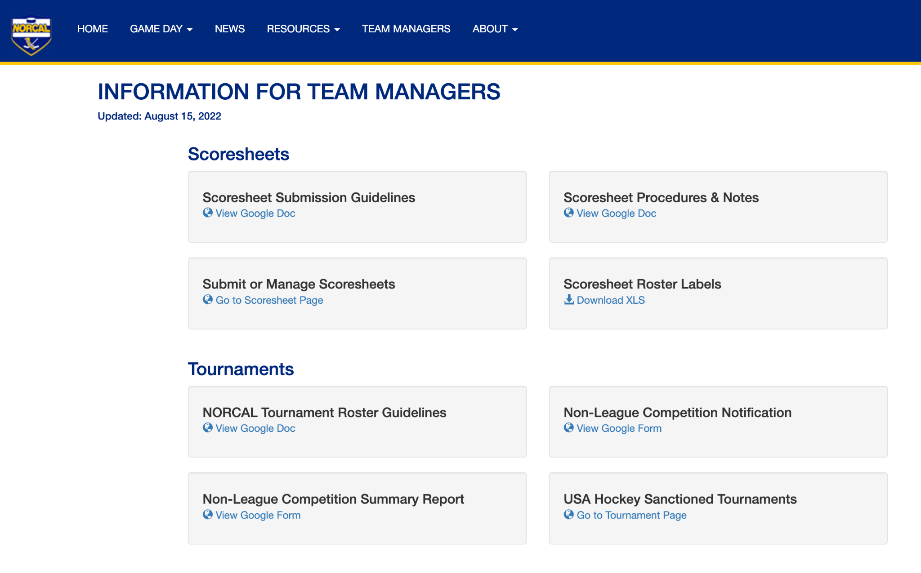
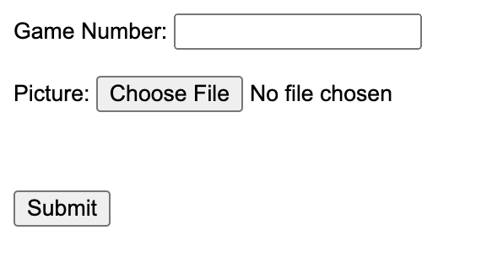

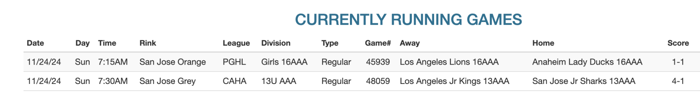
Scoresheet
Submission
1
Go to NorCal Team Manager Page - link here
2
After taking a picture of the paper scoresheet upload with Game #.
Click Submit button!
3
NorCal Game Day - Today’s Game and find corresponding Game#

Slide 18
Tournament
Rosters
Need tournament host’s prior approval for tournament rosters with players moving down from a higher level
To participate on a team other than their own regular season team, players must be added ON A TOURNAMENT ROSTER, (and NOT removed from their regular roster)
Tournament rosters are valid for 1 event only and must be submitted at least 14 days in advance

Slide 19
Tournament
Housekeeping
At least 7 days before the tournament, submit
NORCAL Non-League Competition Form (if not, $100 fee)
If traveling to Canada, submit USA Hockey Travel Permit (your club registrar has the form) ASAP and no less than 14 days before travel
Before tournament, send game schedule to your club’s Ice Scheduler for game numbers so tournament scoresheets can be uploaded within 48 hours of last game

Slide 20
Sanctioned Tournaments
During regular season (8/1-4/30), teams can only play in USA Hockey sanctioned tournaments/games
For CAHA sanctioned tournaments: https://www.caha.com/tournament_list.pl
Other USA Hockey: https://www.usahockey.com/tournaments
IMPORTANT: look for "USA Hockey sanctioned” AND a sanction number.

Slide 21
Exhibition Games VS
Scrimmages
Exhibition games:
  Teams from two different clubs
  Pre-planned
  Requires officials and game sheets
  Game sheet must be submitted
Scrimmages:
  Controlled practices between two teams of SAME club
  No officials or game sheets
** If two teams from same club choose to use game sheets and officials, it is classified as an exhibition game and must be reported at end of the game
NEVER play a game against a team without an approved USA Hockey roster.

Slide 22
Important CAHA updates!
Youth A/BB/B teams must play an overall minimum of 14 games to qualify for CAHA state playoffs (down from 20); players must play 7 games (down from 10).
NorCal and SCAHA now incorporates 12AA as travel with A/BB/B
8U team approved travel states are California, Oregon, Arizona, Nevada and Utah.

Slide 23
NorCal Preseason
Labor Day PreSeason Jamboree
  Sept 4-7 (4 games)
9/11-12
  Ex games only
  No pre scheduled games
9/19-20
  1-2 preseason games
9/27-28
  Bubble weekend

Slide 24
NorCal Important Dates
** each team gets one blackout weekend request**
10/3-4 (or earlier for some)
  Regular Season starts
NorCal blackout weekends:
  Thanksgiving weekend
  Holiday break 12/27-28
  MLK 1/17-18
  Presidents Day 2/14-15
3/6-7 (tentative)
  End of Regular Season
3/12-14 (tentative)
  NorCal Playoffs
3/26-28 (location TBD)
  States A/B/BB/12AA
** Jan 2-3 2027 will be playable weekend**

Slide 25
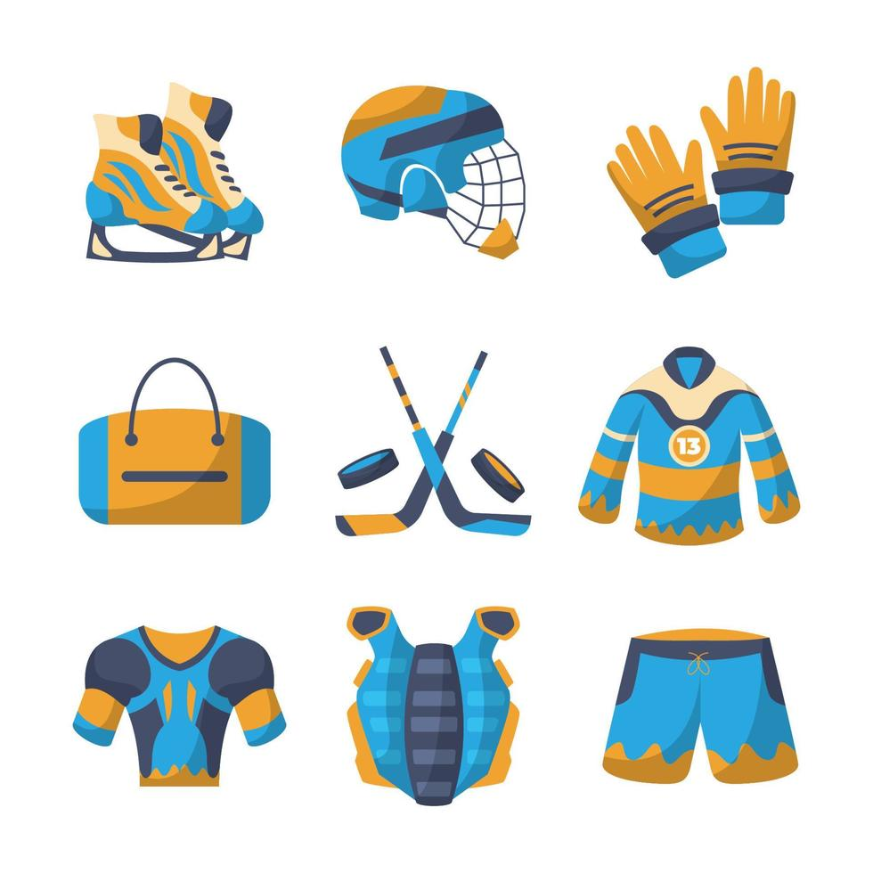
Equipment Requirements
Neck guard or neck laceration required
Mouth guards (12U and up)
Properly fitting helmets
Check expiration of equipment

Slide 26
Working with your club…
Team Managers need to contact their association registrar or club hierarchy with questions/concerns, not USA Hockey National Office, NorCal board members or USAH Registrars.

Slide 27

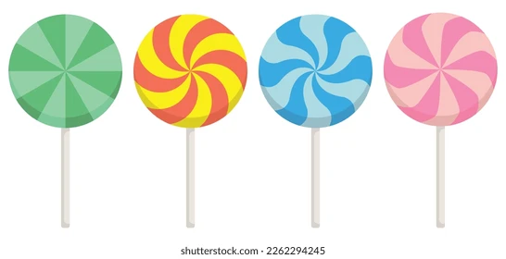
Parent
Behavior Guidelines

Slide 28
Disciplinary Topics
1
2
3
Game Misconducts
Match
Penalties
Suspensions
4
5
6
Spectator Ejections
Hearings
Questions

Slide 29
Key USA Hockey Rule Changes
Rule
Rule | Title | Change
601(c)&(d) | Abuse of Officials and Other Misconduct | Mandates game misconduct penalty to player or coach who uses obscene, profane or abusive language to any person after the game.

Slide 30
Game Misconducts
Game Misconduct is a game suspension and must be served in next pre-scheduled game with same team . If no longer playing with that team; it will be the next scheduled USA Hockey game.
Any game misconduct issued in a CAHA sanctioned league game is to be served in a CAHA recognized league game or in a pre-scheduled tournament or event game.
Important to note game misconducts must be noted on the scoresheet(s) of the game(s)
Failure to serve will deem the player/coach ineligible and additional suspensions and/or forfeits may apply.


Slide 31
Game Misconducts
A player receiving a Game Misconduct or Match Penalty must leave the game.
Each misconduct adds 10 minutes to the player’s total season penalty minutes.
Automatic Game Misconducts include: 4+ penalties in a game
2+ misconducts
2+ major penalties
Head Coach: auto GM when TEAM receives 12 or more penalties in a game.
Note: A “Misconduct” is not the same as a “Game Misconduct.”

Slide 32
Match Penalties
.
Player/coach immediately suspended from all team/USAH events (games, practices, etc.)
The player/coach may request a hearing. Otherwise, suspension will expire in 30 days.
Most Match Penalty hearings are held by the CAHA 1st VP. The outcome of the hearing may include a reduction, increase or stay of the 30 day suspension. (Hearings are 1st & 3rd Wednesday of the month.)
If a player is ejected from a game, they need to leave the bench and rink.
Report all Match Penalties to the NORCAL Vice President at vp@norcalyouthhockey.org & NORCAL GM gm@norcalyouthhockey.org within 48 hours

Slide 33
Spectator Ejections
Spectator, coach, player, and parent conduct, before, during, and after a game is subject to review and possible sanction by CAHA
Spectators/coaches/managers/players/
parents are prohibited from approaching game officials as the officials are coming off the ice and walking to their locker room, or to/from the facility.
Any abusive behavior or language towards an official will result in a spectator ejection (including any/all subsequent telephonic or electronic communications).
Report all Match Penalties to the NORCAL Vice President at vp@norcalyouthhockey.org & NORCAL GM gm@norcalyouthhockey.org within 48 hours

Slide 34
Spectator Ejections
If an official deems it necessary to eject a spectator:
The spectator will be ejected, will leave the rink property and not be allowed re-entry to the property for a minimum of 3 hours.
If and when possible, the scoresheet will document that an ejection occurred; including the spectator’s name if known. The referee will file a report within 48 hours with the League.
The club of the offending spectator will be fined $500 per ejection, payable to NorCal within 30 days. Each offending spectator shall pay the fine to his/her respective club.
The spectator is immediately suspended from all USA Hockey activities for 30 days. A hearing shall be held upon request.
The team Manager is responsible for facilitating compliance with this rule including assisting with identification of the offending party.
Persons receiving a 2nd spectator ejection at any time in the same playing season are banned from CAHA sanctioned games in California for the remainder of the season.
Teams with multiple spectator ejections at any time in the same playing season may be subject to a ban on parent/spectator attendance for the remainder of the season
Report all Match Penalties to the NORCAL Vice President at vp@norcalyouthhockey.org & NORCAL GM gm@norcalyouthhockey.org within 48 hours

Slide 35
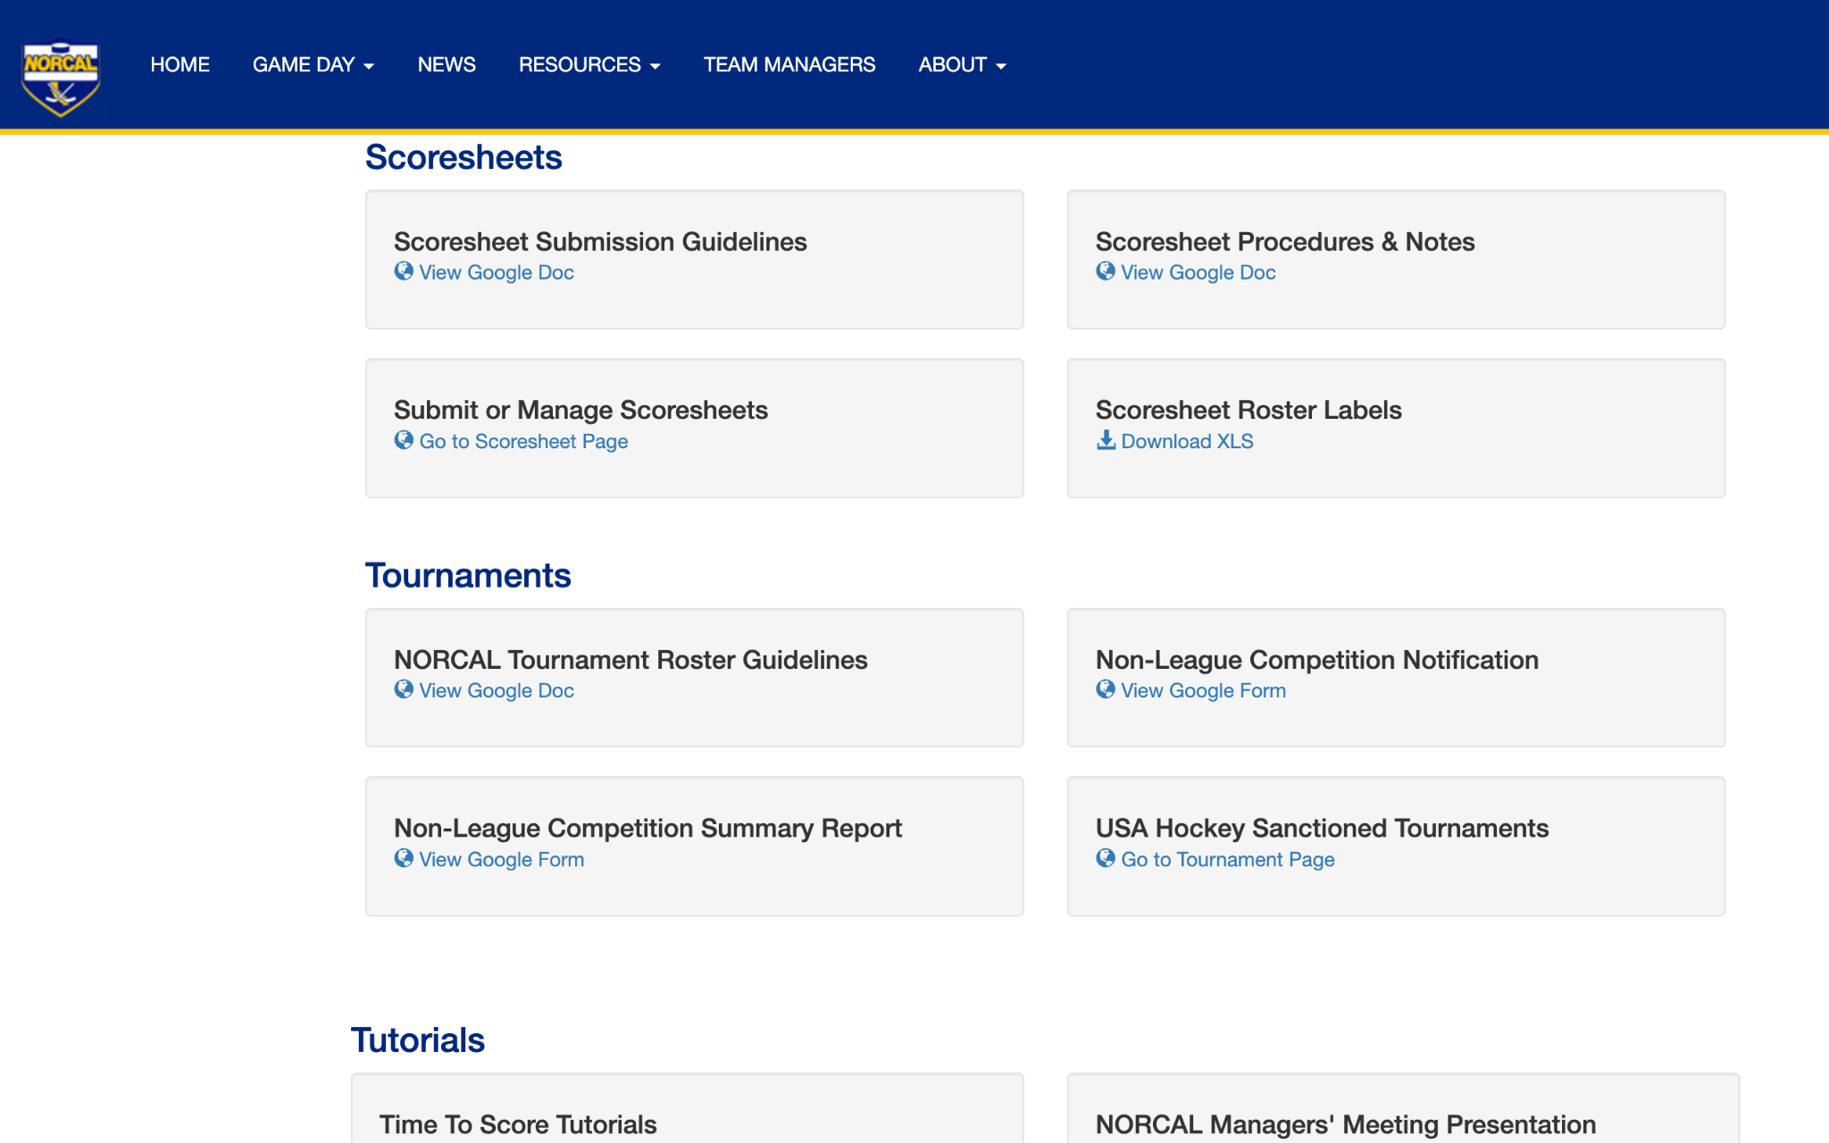
NorCal Website
Team Manager resource area

Slide 36


Hockey Rules & Resources
USA Hockey
  https://www.usahockey.com/rulesandresources
CAHA
  http://www.caha.com/view.pl?p=guidebook.htm
NORCAL
  https://norcalyouthhockey.org/Rules.html
  TTS Demo Link

Slide 37
Thank you!!! Questions ?

